Slide 1
Chapter 6
Data Seeder

Slide 2
Outline
Data Seeder
Faker library

Slide 3
DatabaseSeeder

Slide 4
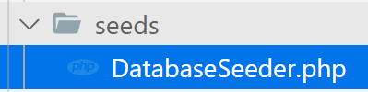
Seeder Class
Seeding your database with test/dummy data using seed classes

Slide 5
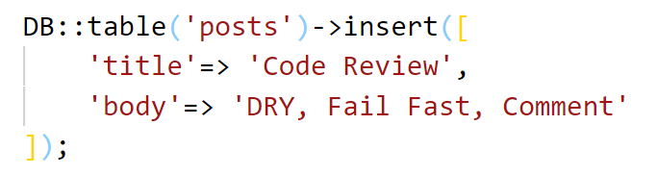
DatabaseSeeder run()
Insert a record into the posts table
To insert data into database use
php artisan db:seed

Slide 6
Faker

Slide 7
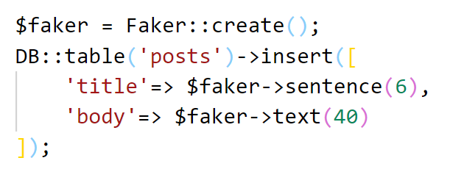
Faker library
It is php library to generate good random data

Slide 8
Activity[15mn]
Seeding 1000 random dummy data into your students table by using seeding and faker library

Slide 9
Create Seeder class
Create seeder class
Write the same insert data in the run() function
Call it inside the run() of DatabaseSeeder
Finally run command
php artisan db:seed

Slide 10

Seed specific class

